Slide 1
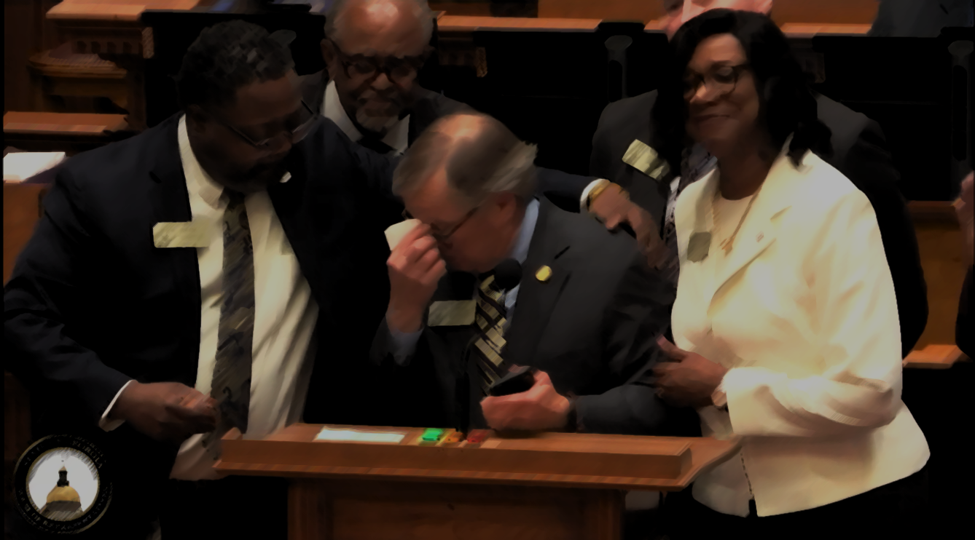

THE BATTLE FOR MODERN TORT REFORM

Slide 2
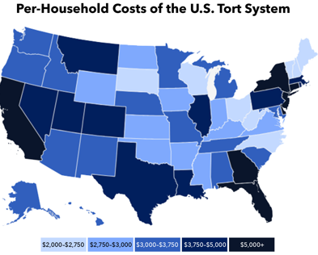




Modern Tort Reform
Where Will Reforms Benefit Business Most?
NORDICS/US litigation update
Top States for Nuclear Verdicts (per capita)
Florida
New York
Pennsylvania
Illinois
California
Georgia
Missouri
Texas
New Mexico
Washington
Top Cities Renown
For High Awards
Atlanta, GA
Chicago, IL
Houston, TX
Los Angeles, CA
Miami, FL
New York City, NY
Philadelphia, PA
San Francisco, CA
Seattle, WA
St. Louis, MO

Slide 3
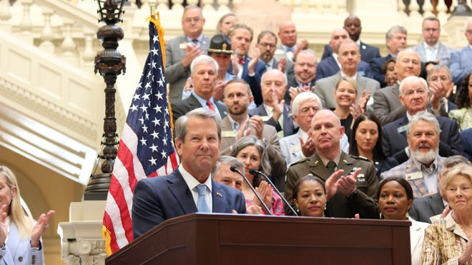
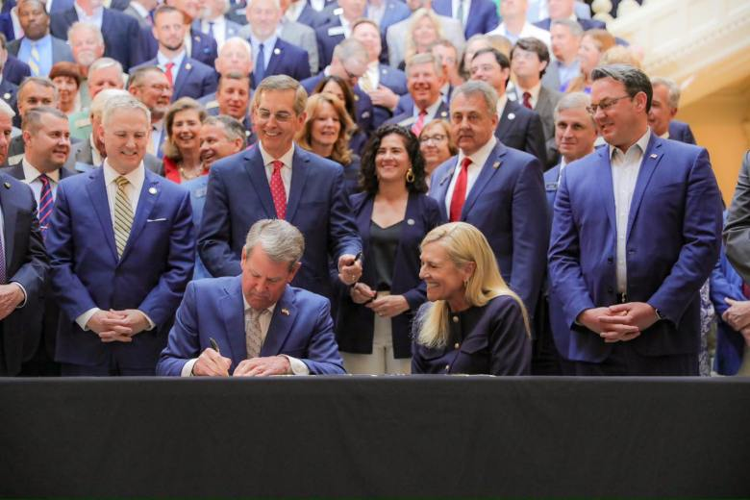
GEORGIA SB 68/69 (2025)
NORDICS/US litigation update
Anti-Anchoring: Only damages "rationally related" to facts
TPLF Regulation: Mandatory disclosure of funders; bans foreign-affiliated funding
Mandatory Bifurcation: Ability to split trials—liability decided before the jury hears about damages
Seatbelt Admissibility: Evidence of non-use now admissible for negligence and fault apportionment
No “Phantom” Damages: Reorients medical value to "reasonable" levels using both billed and paid amounts
Negligent Security: Juries must now apportion fault to the criminal perpetrator, not just the property owner
No “Direct Action”: Plaintiffs no longer can sue insurers directly to name a “deep pocket,” in certain cases

Slide 4
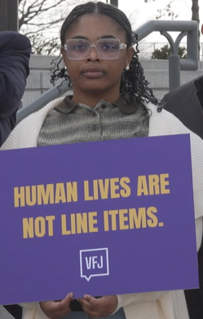
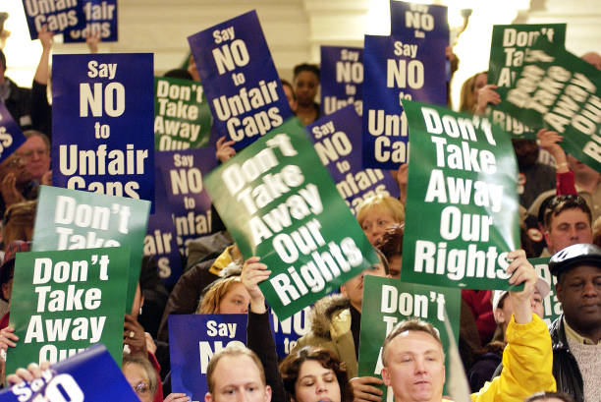
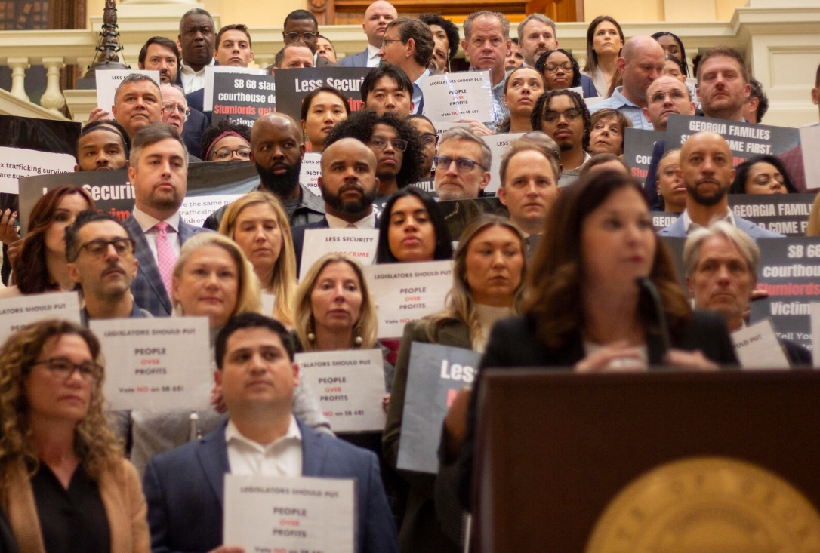
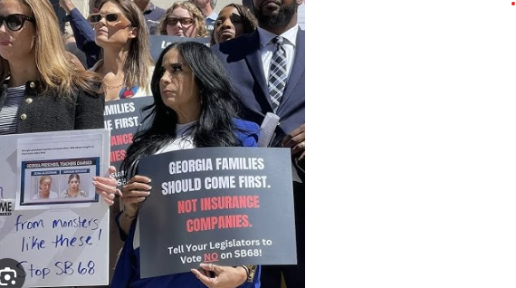

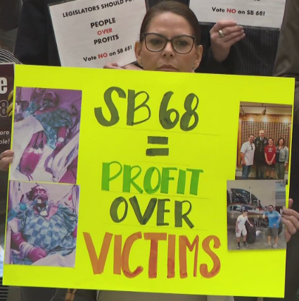
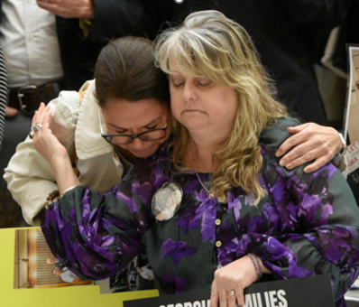
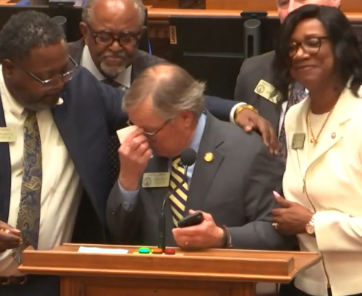

Slide 5
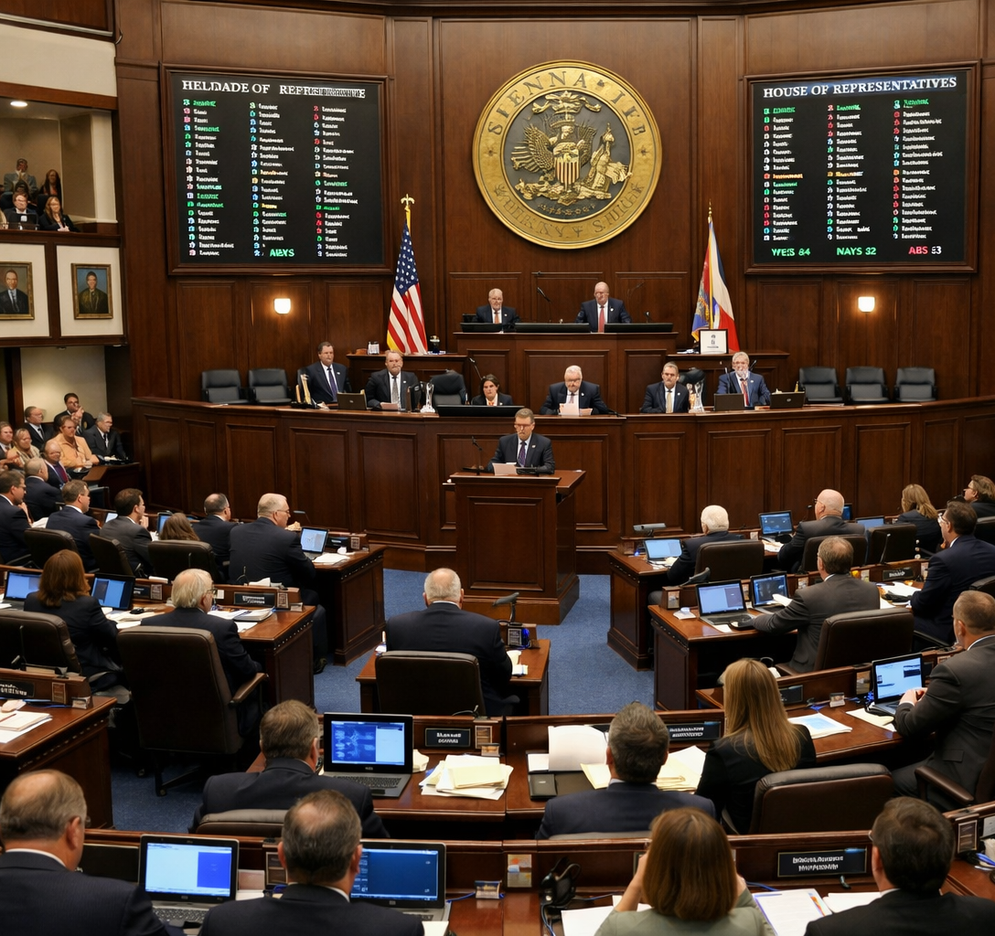
FLORIDA HB 837 (2023)
NORDICS/US litigation update
Modified Comparative Fault: Plaintiffs >50% at fault are now barred from recovery
Truth in Damages: Medical damages limited to actually paid / payable, eliminating "phantom damages"
Bad Faith Reform: 90-day safe harbor to tender policy limits; "mere negligence" is no longer bad faith
Attorney Fee Reform: Eliminated one-way fee shifting; restored "strong presumption" of the lodestar fee
Premises Liability: New protections for owners who implement defined security measures; criminal perpetrator must go on verdict form
Statute of Limitations: Reduced general negligence filing window from four years to two years

Slide 6
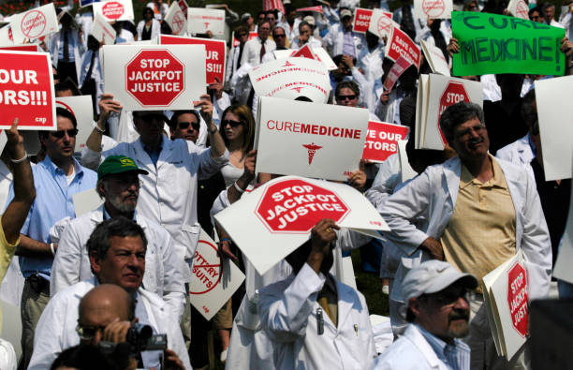
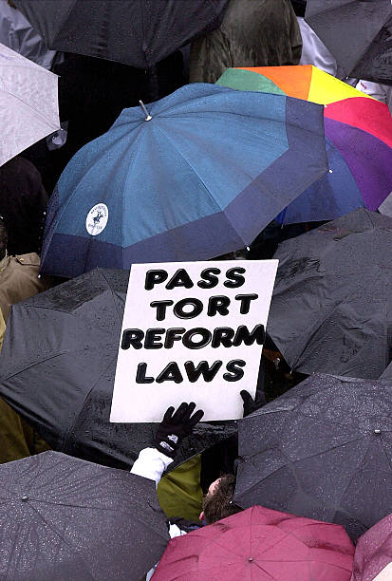

National Picture
State & Federal Momentum
NORDICS/US litigation update
Arkansas: Limits damages to sums actually paid
California: Modernized caps for medical malpractice
Indiana: Seatbelt evidence admissible; TPLF disclosure
Iowa: $5 million cap on trucking verdicts
Kansas: Anti-anchoring bill under consideration
Louisiana: Modified comparative fault / no liab. if >51% fault
Montana: Reforms on noneconomic damages
Oklahoma: Noneconomic damage caps; TPLF disclosure
S. Carolina: Curbs joint & several; non-parties on verdict form
Texas: HB 939 proposes caps to all personal injury cases
U.S. Federal: Bill stalled in Congress; no clear timeline

Slide 7

The Road Ahead: Challenges & Adaptation
NORDICS/US litigation update
Short-term spike: Plaintiffs will race to secure pre-statutory frameworks
Pronounced Lag: Three-to-five-year gap between enactment and observable impact / actuarial maturity (est. 12% to 15% loss ratio improvement)
Legal Challenges: Constitutional challenges expected on damage caps and apportionment rules
Judicial Inconsistency: Expect uneven adoption in trial courts during the initial phase
Plaintiff Adaptation: Anticipate tactical shifts like forum shopping and refined anchoring

Slide 8

TORT REFORM IN ACTION

Slide 9



Personal Injury Scenario One:
Premises Liability / Negligent Security In Florida
Security Firm provides in-store security for Retailer with multiple outlets in US
Customer of Retailer is seriously injured during a robbery attempt
Security Firm and Retailer implemented cameras, lighting, locks, and crime-prevention training to provide adequate security, but Customer alleges these were insufficient
Customer’s Alleged Damages = $4,000,000
    Hospital “sticker price” $500,000
      Actual paid = $125,000
    Future care “sticker price” $1,000,000
      Actual paid = $250,000
      Pain & Suffering $3,000,000
      Lost Wages $500,000

Slide 10
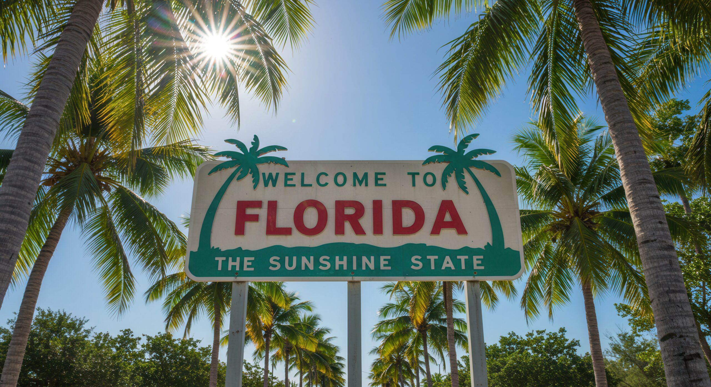
Personal Injury Scenario One:
Premises Liability / Negligent Security In Florida
Before Florida Tort Reform
Estimated Settlement Range: $2,250,000 – $3,000,000
Medicals (billed) $500,000 (past) + $1,000,000 (future)
Pain & Suffering $3,000,000 (2x medicals)
Lost Wages $500,000
Criminal not on verdict form: Only Retailer and Security Firm share liability
Comparative fault: no threat of zero recovery
No presumption of adequate security; burden on defense
Inflated damages; limited defenses; no risk of zero recovery for plaintiff; strong pressure – defense motivated to settle to avoid risk of large verdict

Slide 11
Personal Injury Scenario One:
Premises Liability / Negligent Security In Florida
After Florida Tort Reform
Estimated Settlement Range: $180,000 – $250,000
Medicals (actual paid) $125,000 (past) + $250,000 (future)
Pain & Suffering $750,000 (2x medicals)
Lost Wages $500,000
Criminal on verdict form, so jury likely assigns at least 50% to actual perpetrator of crime
Customer’s comparative fault Award is $0 if over 50%
Statutory presumption of adequate security; burden on plaintiff
Lower damages; significant apportionment to criminal; risk of zero recovery; statutory presumptions for security measures drive settlement values down

Slide 12
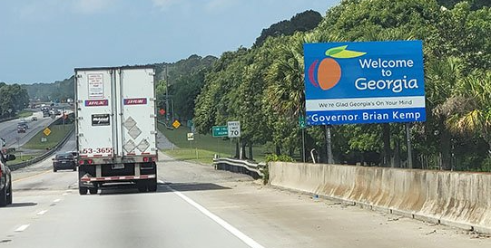
Personal Injury Scenario Two:
Trucking Accident / Equipment Safety In Georgia
Truck Manufacturer’s accident avoidance technology product is involved in serious highway accident involving multiple fatalities
Emotionally-charged narrative around plaintiffs
  MOTIVATES JURY TO CREATE LIABILITY + AWARD DAMAGES
Plaintiffs not wearing seatbelts
  INADMISSIBLE, NO FAULT APPORTIONED
Significant driver fault
  INSURED SOLE PARTY ON VERDICT FORM

Slide 13
Personal Injury Scenario Two:
Trucking Accident / Equipment Safety In Georgia
Truck Manufacturer’s accident avoidance technology product is involved in serious highway accident involving multiple fatalities
Emotionally-charged narrative around plaintiffs
  SEPARATE LIABILITY FROM DAMAGES = CLARITY ON FAULT
Plaintiffs not wearing seatbelts
  INTRODUCES COMPARATIVE FAULT = REDUCE DAMAGES
Significant driver fault
  EMPTY CHAIR DEFENSE = APPORTION LIABILITY

Slide 14

GLOBAL OUTLOOK

Slide 15

Global Risk Management: Impact of US Reforms
Stabilizes Liability Premiums
Reducing "nuclear verdicts" and unpredictable jury awards allows global insurers to more accurately price risk and stabilize commercial premiums.
Mitigates "Judicial Hellhole" Risk
Reforms curb the hostility of specific local jurisdictions known for bias against multinationals, creating a more level playing field for international defendants.
Lowers Global "Litigation Tax"
Reducing excessive legal friction; removes hidden expenses for international firms doing business in the U.S.
Enhances Underwriting Predictability
Procedural shifts—like Georgia’s mandatory bifurcation—provide a clearer actuarial path, encouraging multinational insurers & reinsurers to maintain capacity in the U.S. market.

Slide 16
THANK YOU

