Slide 1
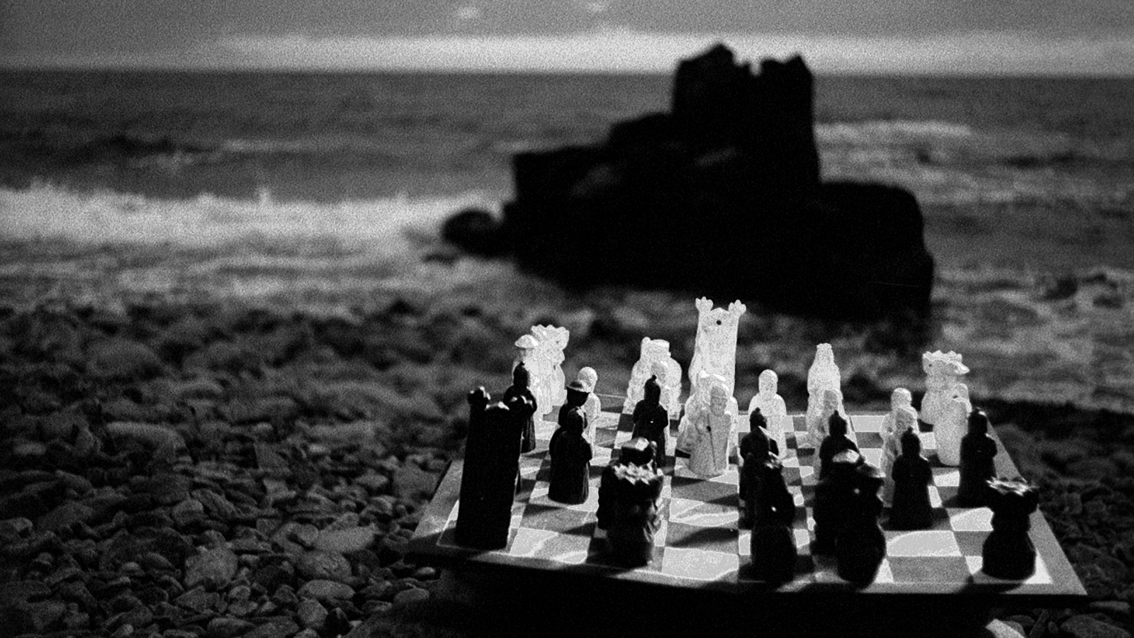
U.S. TORT REFORM FOR NORDIC INSUREDS
NAVIGATING THE NEXT WAVE
Allianz Commercial
Frank Valenti
Global Practice Group Head:
Personal Injury & Class Actions
NORDICS/US litigation update

Slide 2
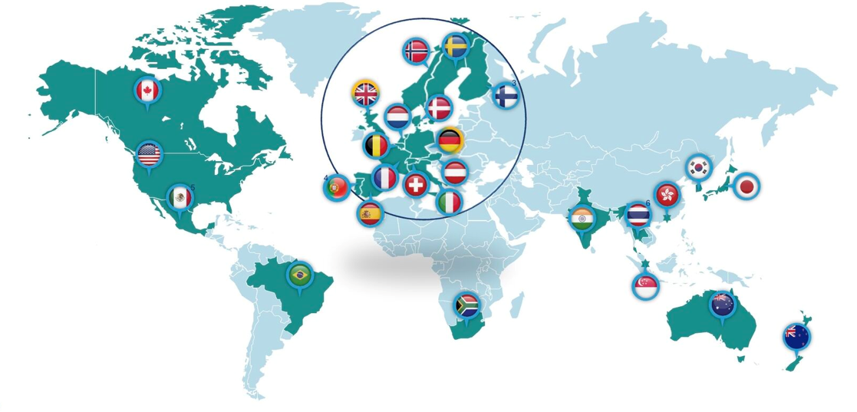
NORDICS/US litigation update

Slide 3
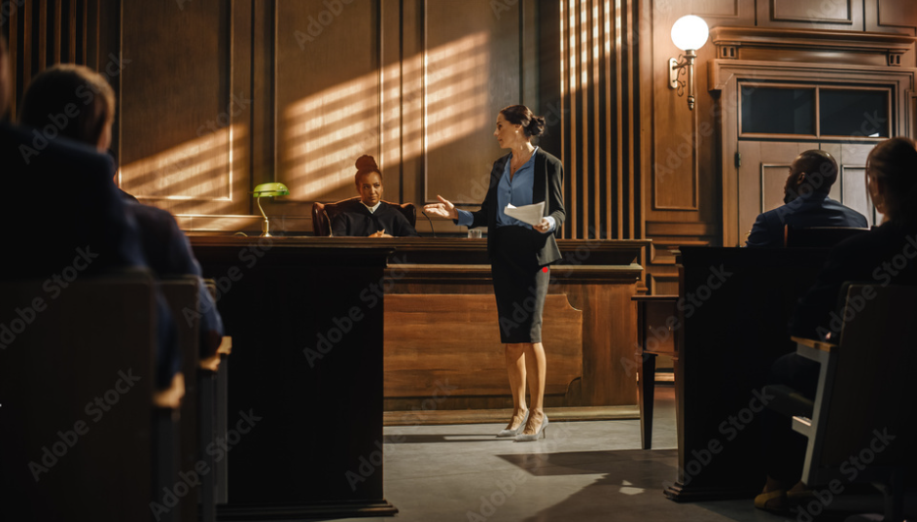
MODERN COURTROOM DYNAMICS

Slide 4
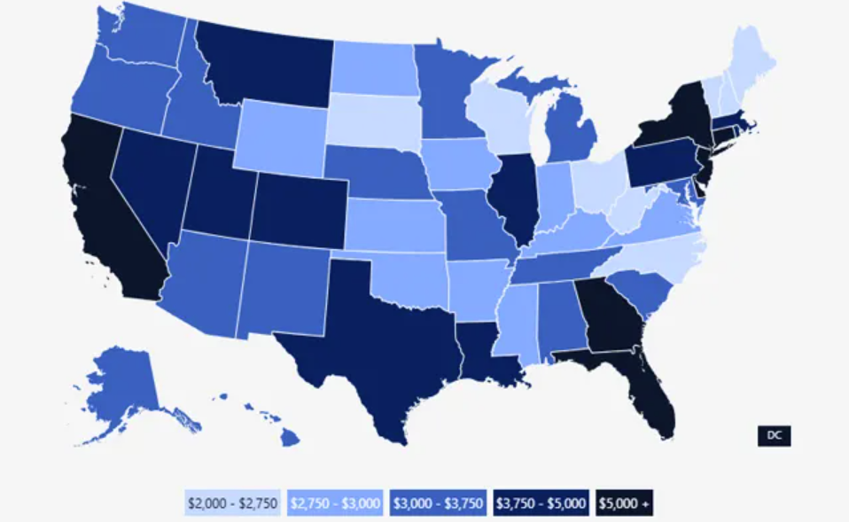
Per-Household Cost of U.S. Tort System
U.S. Chamber of Commerce

Slide 5

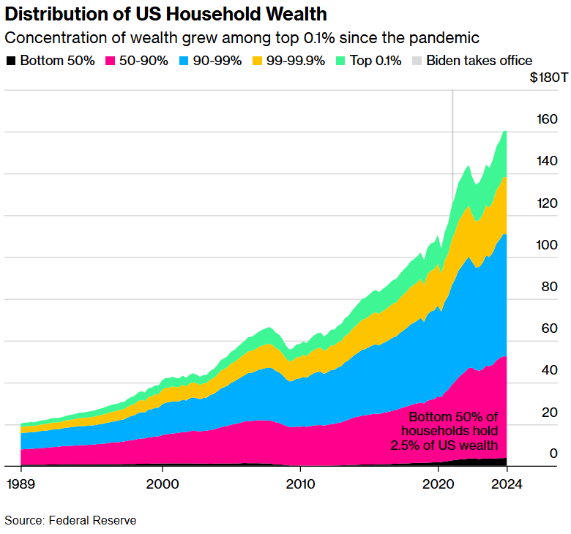

What Drives Social Inflation?
Examining Root Causation
Record Wealth Concentration
The wealthiest 1% of Americans hold 31.7% of household wealth — a historic high — while the bottom 50% of the population holds just 1% of total US assets
Eroding Purchasing Power
Billionaire wealth has quadrupled since 2020
The bottom half of the U.S. has faced a 20% decline in the dollar’s value since 2021
The majority of Americans are unable to cover a $2,000 emergency expense
Generational & Cultural Attitudes (Millennial & Gen Z)
Desensitized to scale, cognitive gap with reality
Eager to embrace a “moral mission” based on good-versus-evil mindset
Face poorer economic prospects than their parents’ generation, leading to a sense of betrayal and outrage toward “the system”

Slide 6
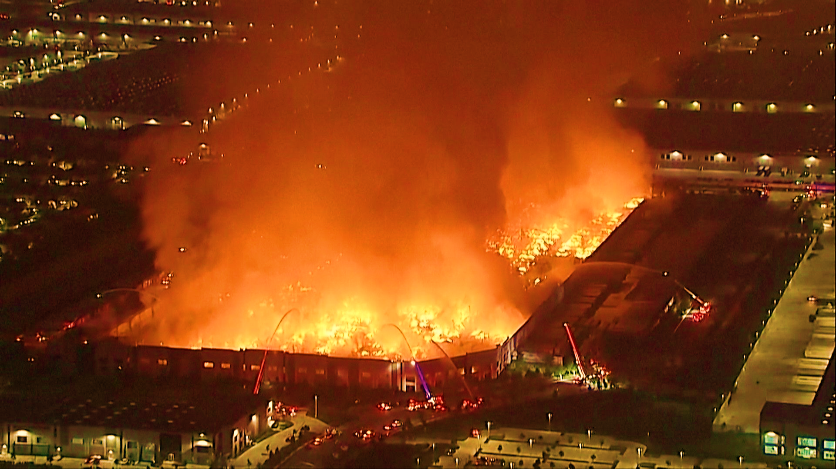
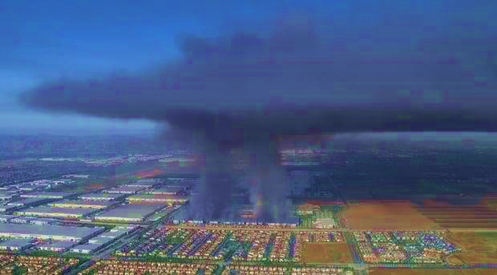
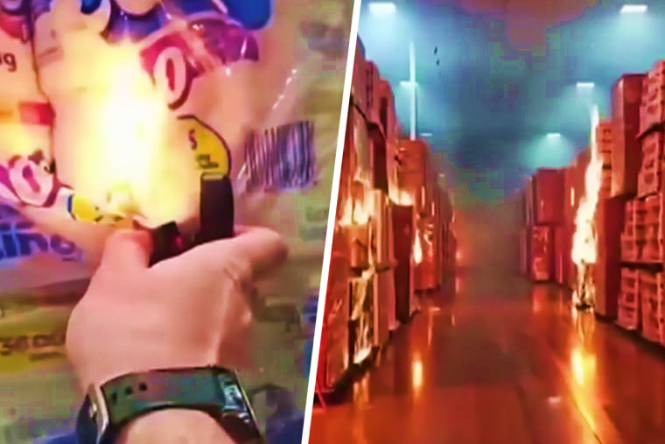
“If you’re not going to pay us enough to live… at least pay us enough not to do this.”
April 7, 2026

Slide 7
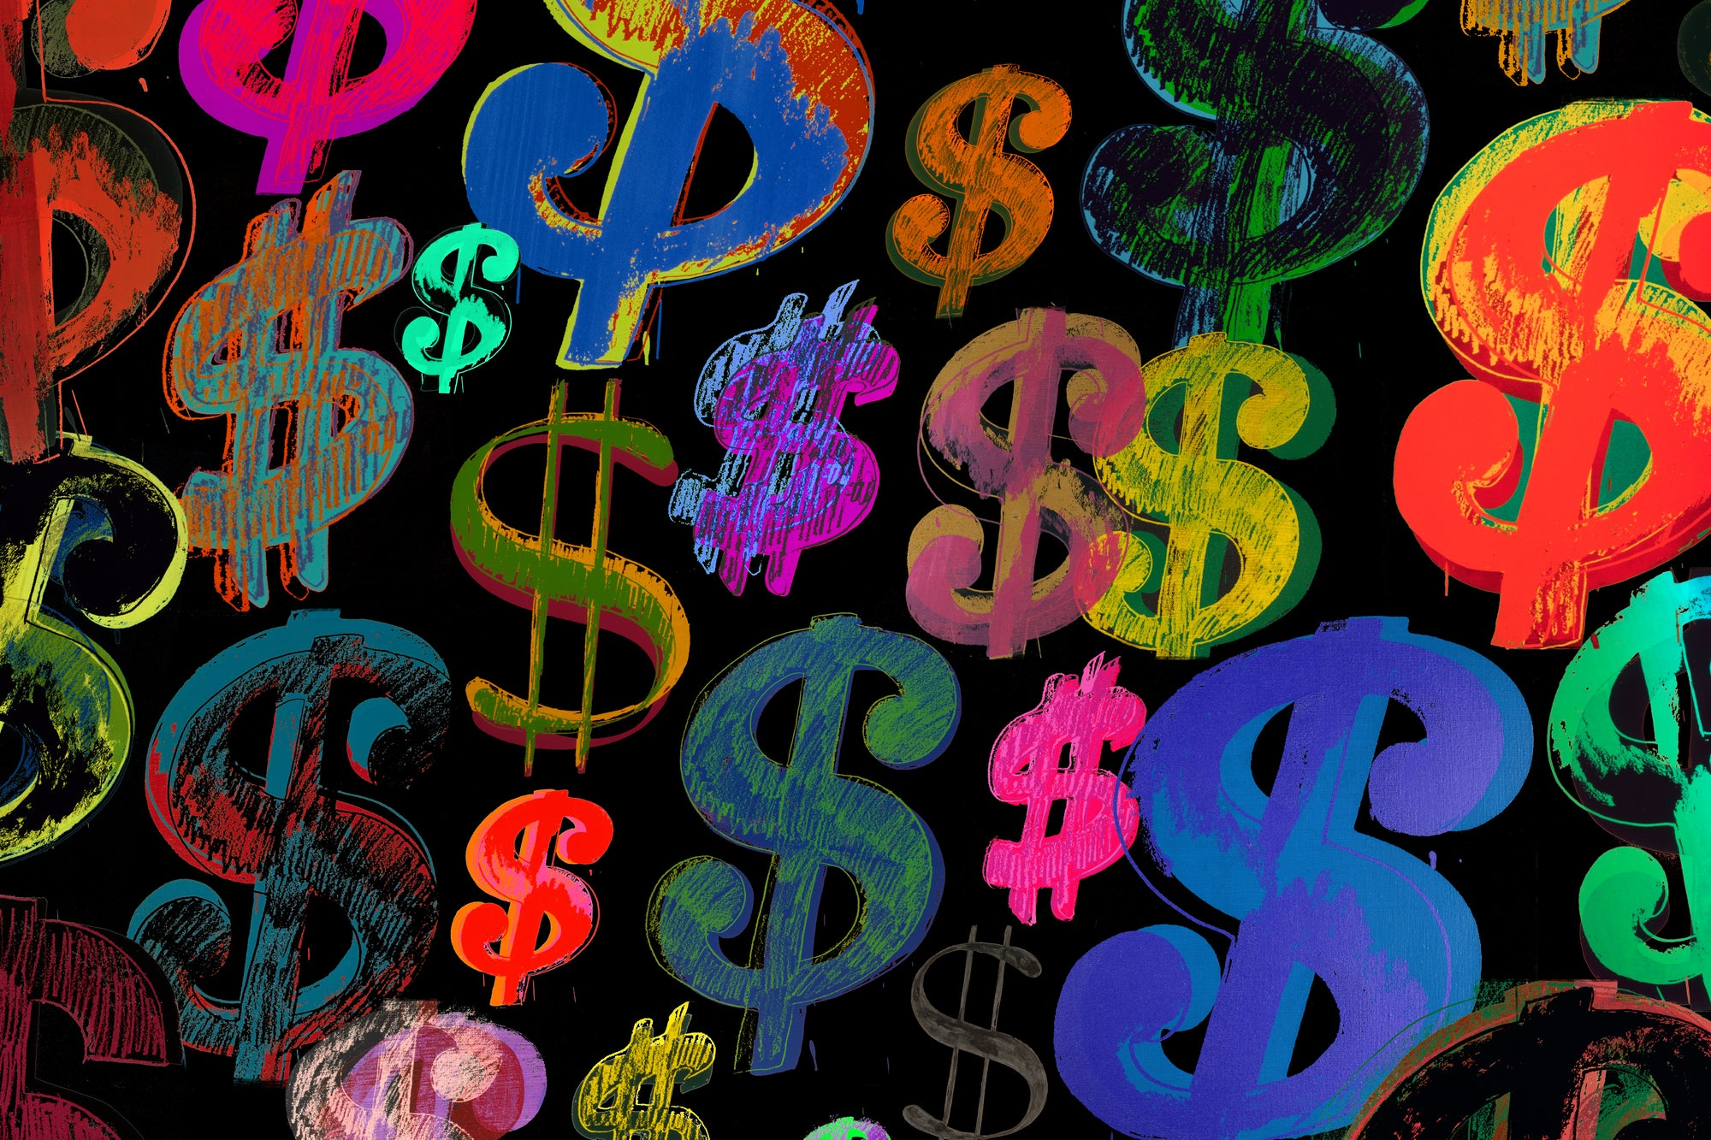
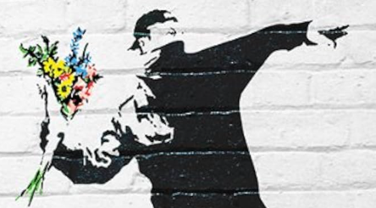
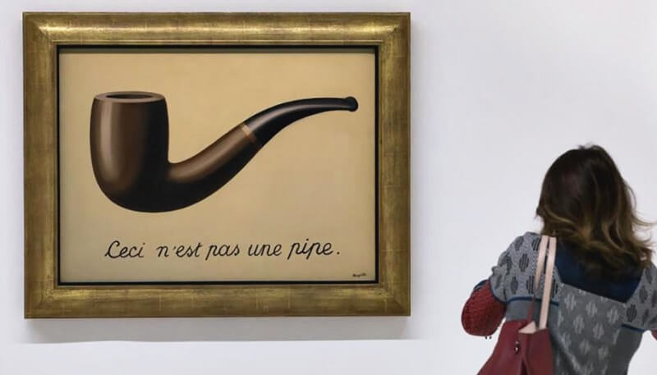
“NUCLEAR” VERDICTS AND SOCIAL INFLATION
REALITY VERSUS PERCEPTION
?
The Crisis
  Median nuclear verdict (> $10M) soared from $21M to $51M since 2020
    Frequency increased 27% in 2023 and 52% in 2024
    “Thermonuclear” (>$100M) verdicts nearly doubled each year since 2023, grew 61% in 2025
The Perception
32% of people think corporations are “inherently evil”
Belief that nuclear verdicts punish corporate greed and indifference
Jurors desensitized by corporate bailouts seek “wealth redistribution”
“Hero” complex, desire to “help”
The Gap
Perception out of sync with reality
Extreme verdicts seen as isolated events rather than systemic problem
The public pays through higher premiums and market instability
Will there be a moment that galvanizes public opinion?

Slide 8
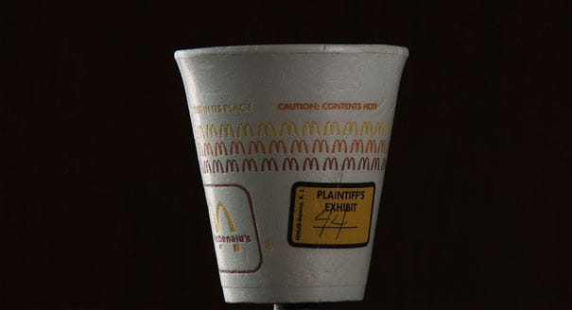
TORT REFORM HISTORY

Slide 9
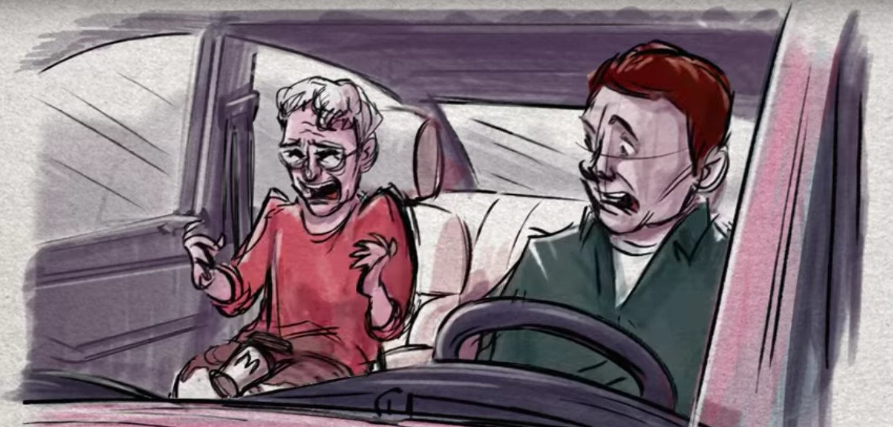

Slide 10
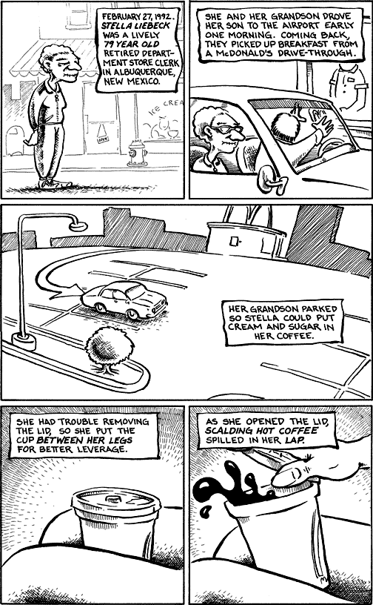
Liebeck v. McDonald’s
New Mexico, 1994
The Injury
Stella Liebeck, 79, suffered third-degree burns on 6% of her body after spilling coffee in her lap while parked. She was hospitalized for eight days and required skin grafts
The Coffee
McDonald's served coffee at 85°C, a temperature that causes third-degree burns in 3 to 7 seconds. Competitors typically served at roughly 70°C
Prior Knowledge
McDonald's received over 700 reports of similar burns over the previous decade but considered the number "insignificant" compared to its volume of sales
Jury Award
The jury awarded $2.9 million ($6M today), $200K in compensatory and $2.7 million in punitive damages—roughly two days of McDonald's coffee revenue

Slide 11
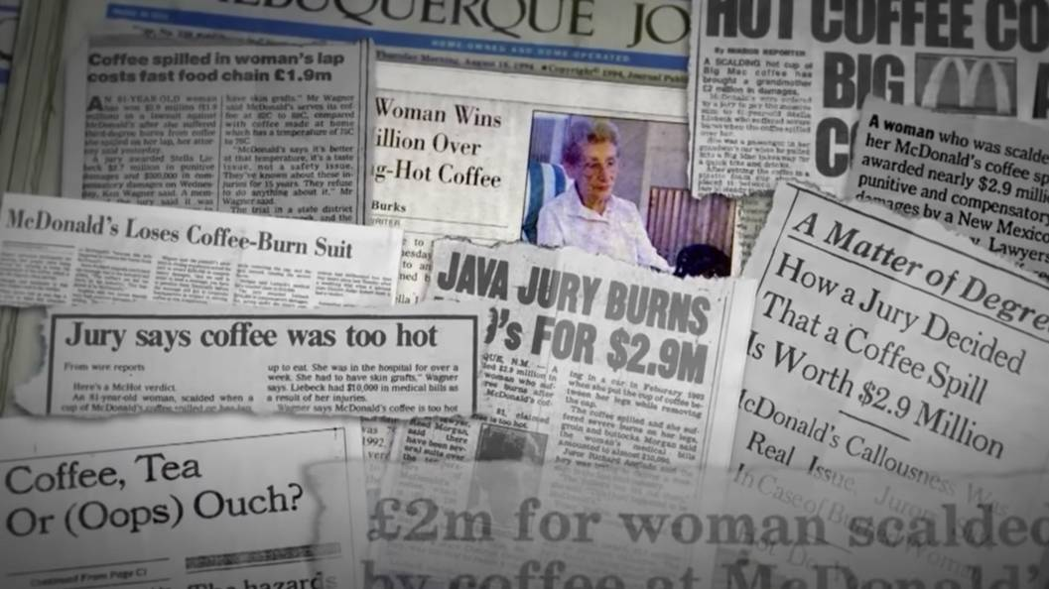

Slide 12
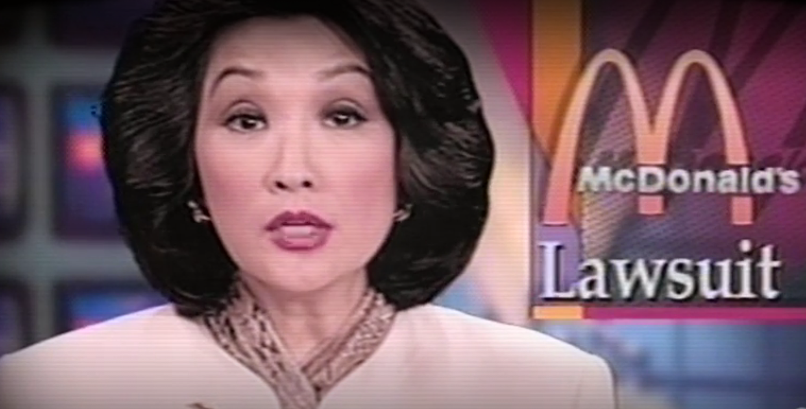
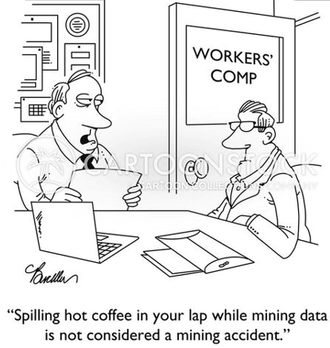
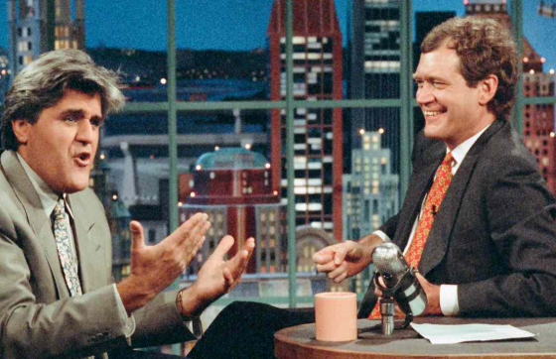

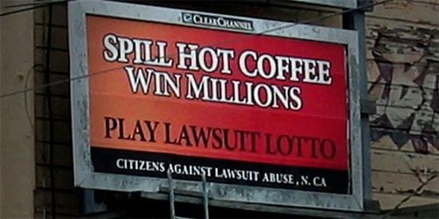
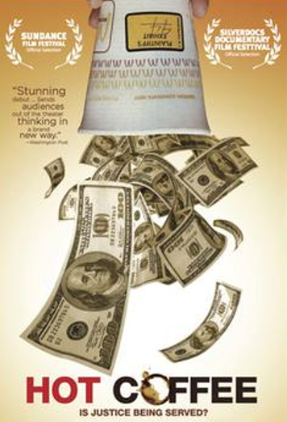

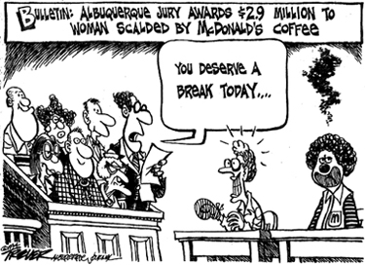
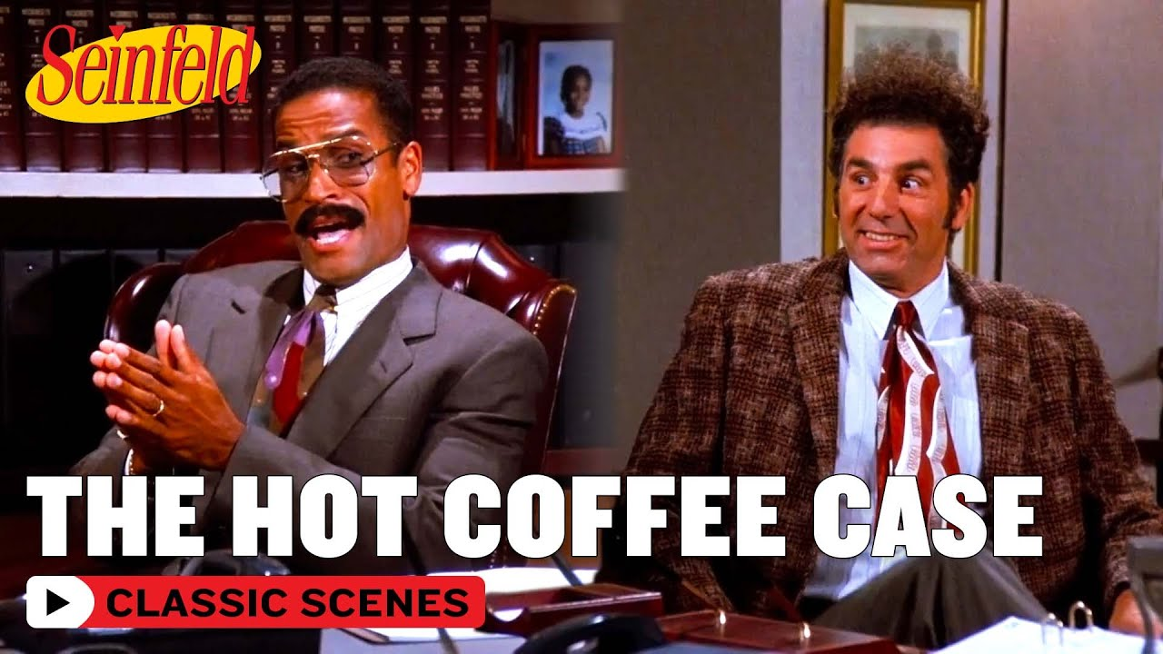

Slide 13
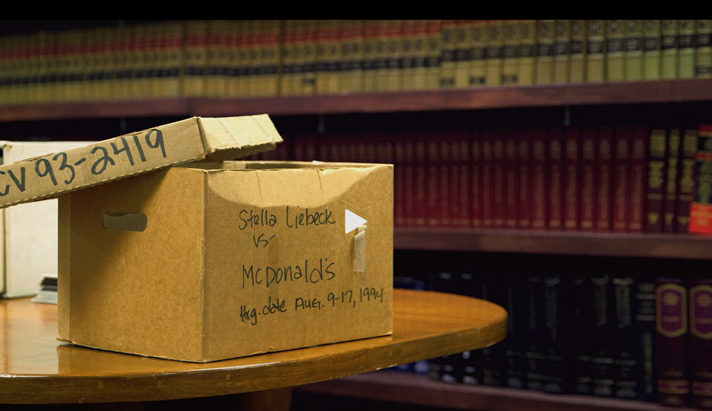

Liebeck – Legacy & Impact
Catalyst for “Second Generation” Tort Reform
“Lawsuit Lottery” Narrative
Tort reform advocates persuaded public that "runaway juries" were awarding millions, against "common sense“
Justified Concrete Legal Actions
State-Level Damage Caps: limiting punitive and non-economic damages, citing Liebeck as justification
Procedural Barriers: New hurdles making personal injury claims more difficult and expensive
Federal Push: Momentum for federal tort reform (vetoed by Clinton, but shifted judicial landscape)
Inspired Judicial Shift
U.S. Supreme Court Response: Restricted punitive damages to "single-digit ratios" (maximum 9x actual damages)

Slide 14
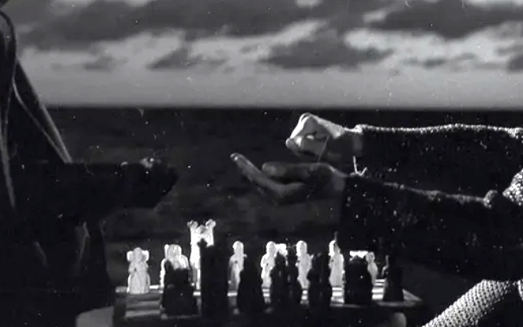
THE MODERN ADVERSARY

Slide 15
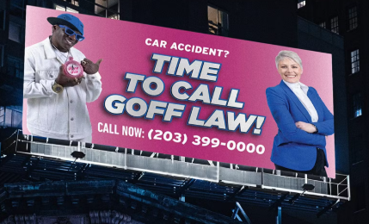
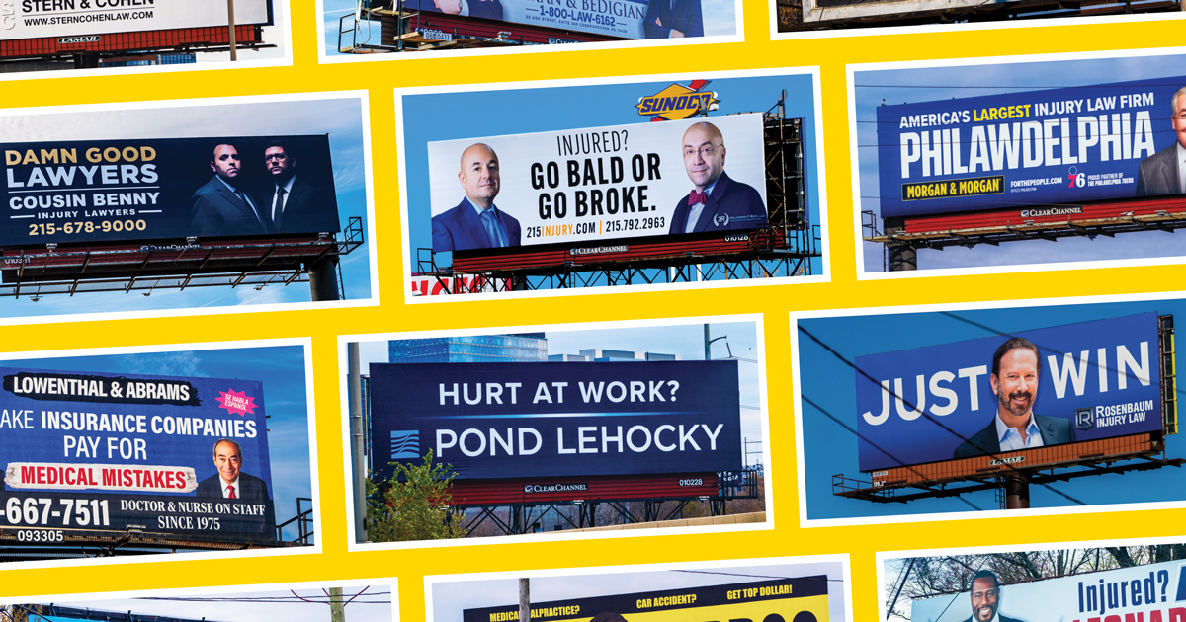
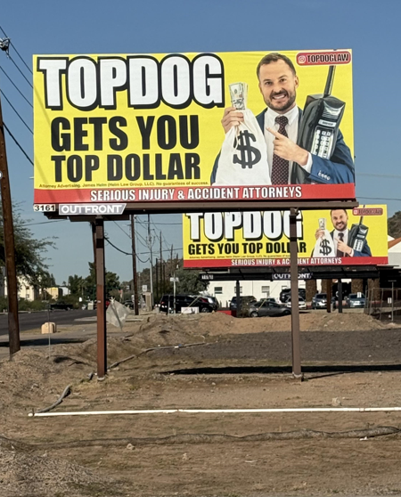
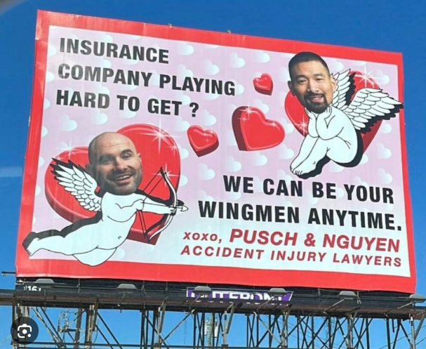
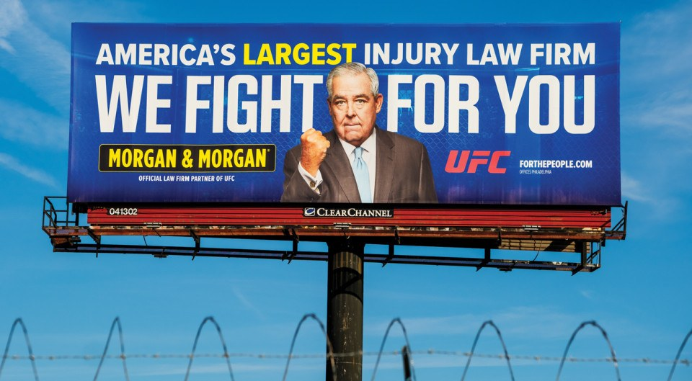
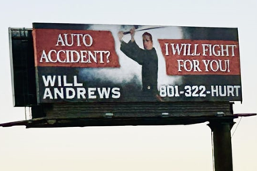
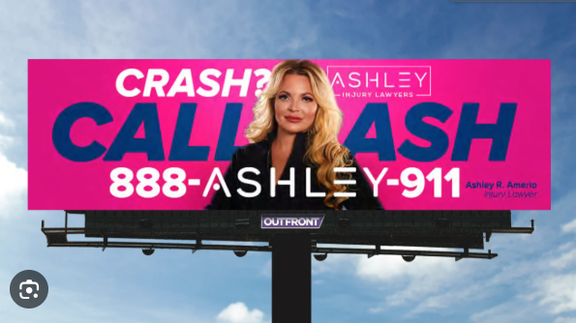

Slide 16

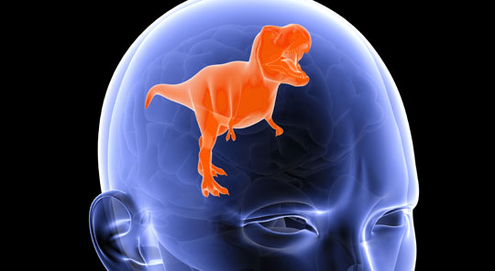
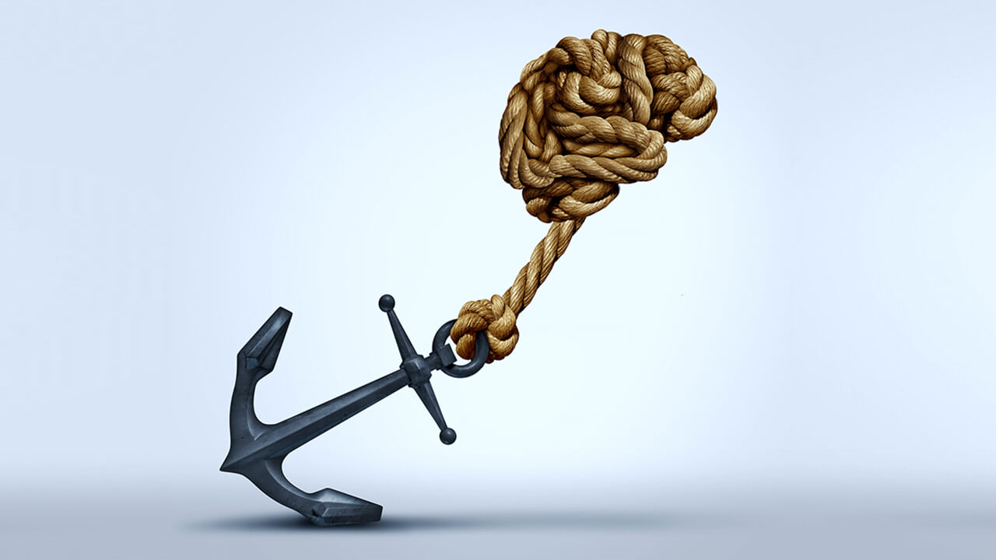
MODERN TORT REFORM
MEETING THE NEW ADVERSARY
Sophisticated Capital
Plaintiffs' firms have nationalized and secured massive Third-Party Litigation Funding (TPLF) to bet on nuclear outcomes
TPLF nearly a $21 Billion industry, with substantial projected growth
"Reptile" Strategies
Based on “triune brain model”
Move past “damages" to frame cases as broad community threats or social / political causes
Appeals to jurors' primitive survival instincts, desire to eliminate danger
Psychological Anchoring
Planting extreme, unrelated numbers to baseline an award early in the trial
Compares human life to high-profile wealth (false equivalence) to incite inflated awards

Slide 17
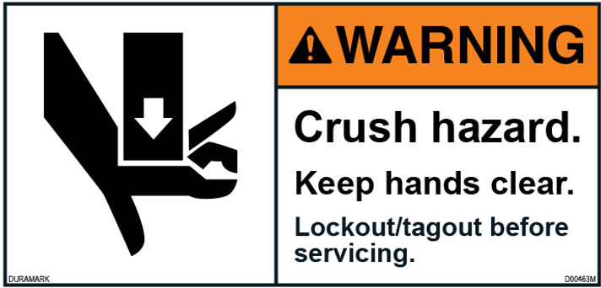
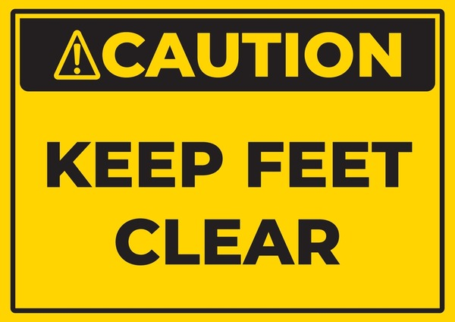
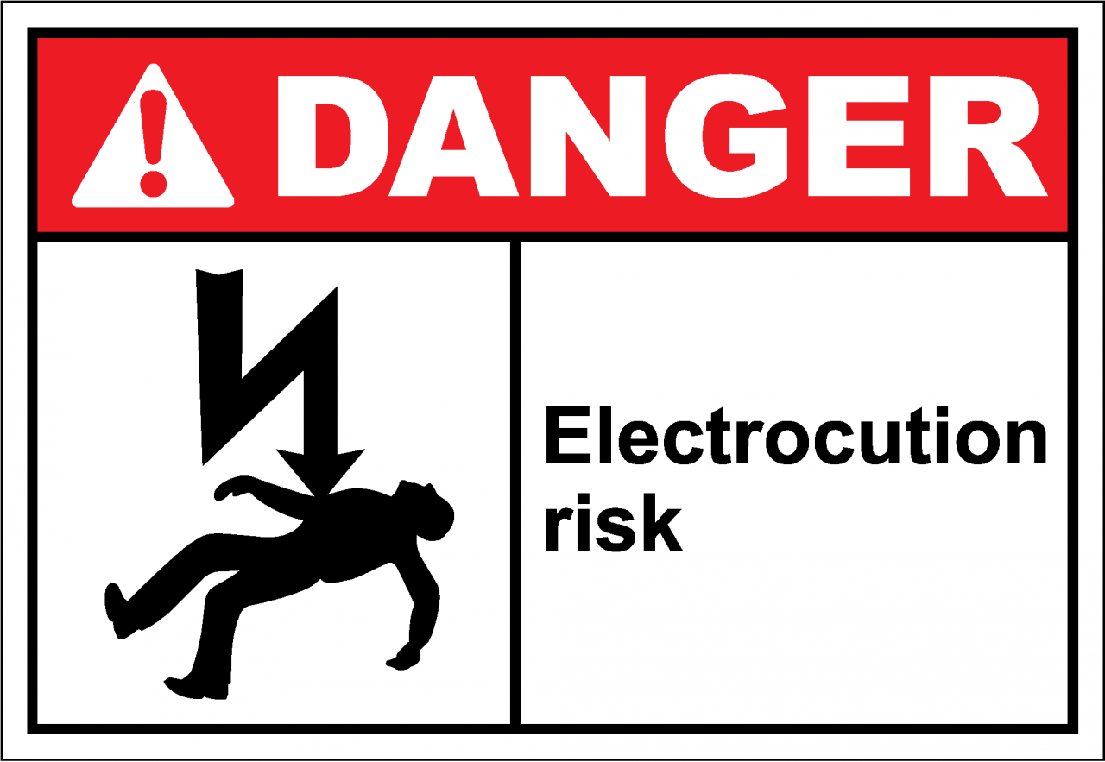
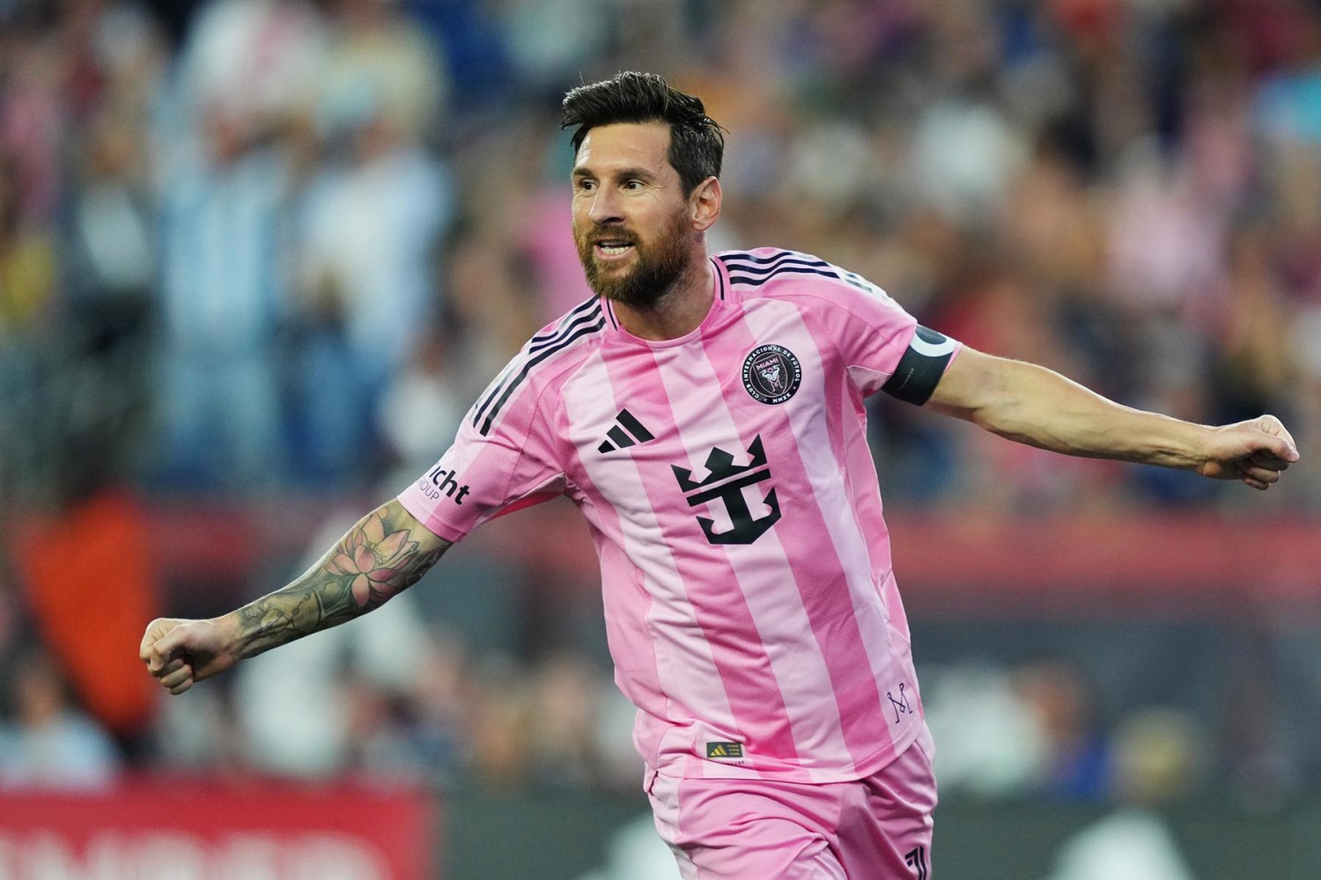
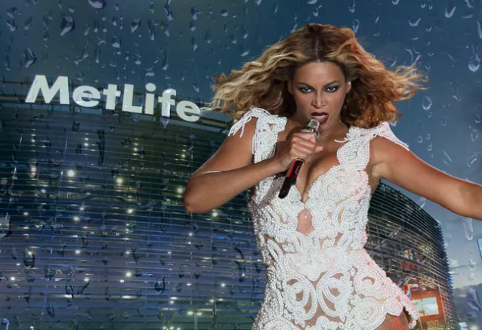
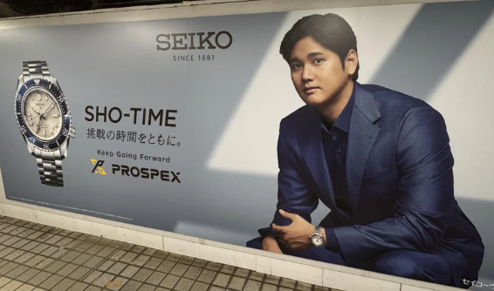
PERSONAL INJURY ANCHORING TACTICS
NORDICS/US litigation update
$5,000,000
$15,000,000
$100,000,000+

Slide 18
