Slide 1

Risk Overview

Slide 2
Risk governance and escalation
Risk Strategy & Board Risk Appetite
Group Risk Policy & General Credit Policy
Credit Instruction
Group Market Risk & Liquidity Limits
Group Trading & Investment Policy
Quarterly Reports (Risk & Asset Quality, Compliance, Audit)
Board of
Directors
Risk & Credit Policies for Products, Segments and risk types.
Portfolio Reviews
Approval of Risk & Capital Measurment Framework
Credit & Risk approvals in special situations or of principle importance (e.g. equity u/w or very large transactions)
Monthly Risk Reporting
RCC
Credit approval
Significant operational risk events
Detailed Risk Tolerance Statement & follow up
Risk Reviews of Countries & Portfolio segments
Risk reporting
GRC

Slide 3
























The building blocks of a universal bank
Operational risk
A lender
A borrower
A depositor
Lender’s capital now referred to as equity
Liquidity reserve to tackle deposit volatility
Long term funding to fund liquidity reserve
Some bond origination, market making etc
Insurance risk
Short term funding to fund net trading assets
Some “bancassurance”
Vulnerable systems and processes
Pension liabilities to employees
Market risk
Liquidity risk
Pension risk
Threats that could take our business away
Credit risk
Business risk

Slide 4
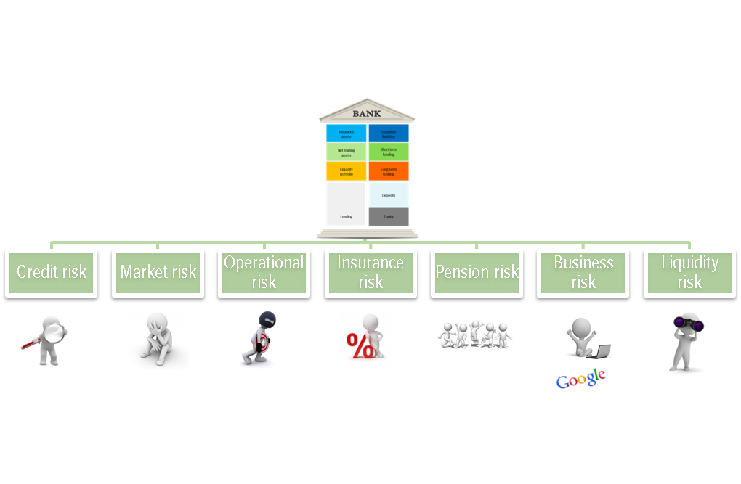
ICAAP
A process
+
A document
Manage
Measure
Buffer
Submitted to FSA
Commented by FSA

Slide 5
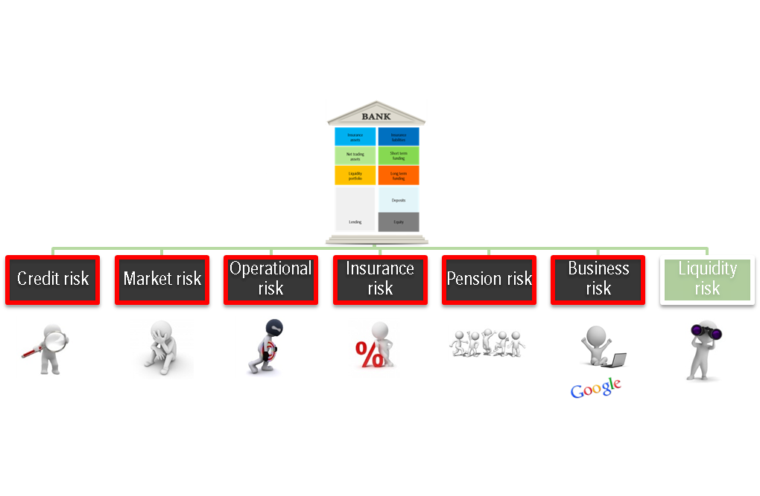
ICAAP
Manage
Measure
Capital buffer

Slide 6
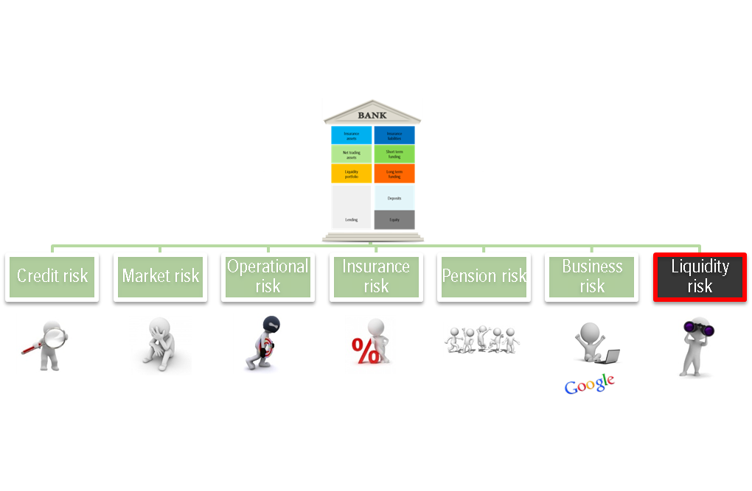
IC(L)AAP
Manage
Measure
Liquidity buffer

Slide 7
The Basel accords have been shaping the banking industry since 1988
Basel I
Credit only approach to capital
To create level playing field
Standards focused on credit risk, the main risk incurred by banks
Criticised as too simplistic
19 pages
1988 Basel I completed
1993 Standardised model for market risk
1996 Internal model
2008 Basel II implemented
2010 Basel III agreed
2013 Basel III implemented
2010 Basel II.5 implemented

Slide 8
The Basel accords have been shaping the banking industry since 1988
Basel I
Credit only approach to capital
To create level playing field
Standards focused on credit risk, the main risk incurred by banks
Criticized as too simplistic
30pages
Basel II
Three Pillars introduced:
I. Minimum capital requirements for credit, market and operational risks
II. Supervisory review of an institution’s capital adequacy and assessment process
III. Market Discipline
Requirements typically decreased
347pages
1988 Basel I completed
1993 Standardised model for market risk
1996 Internal model
2008 Basel II implemented
2010 Basel III agreed
2013 Basel III implemented
2010 Basel II.5 implemented

Slide 9
Basel II introduced a supervisory review (pillar 2) and market disclosure (pillar 3) on top of minimum requirements (pillar 1)
Basel II
Pillar 1
Minimum Capital
Requirements
Pillar 2
Supervisory Review
Of Capital Adequacy
Pillar 3
Market Discipline
Recognition of agency ratings and internal ratings
Recognition of internal exposure and loss mitigation estimates
Explicit treatment of operational Risk
Banks must assess solvency relative to their risk profile
Supervisors review and evaluate risk management and capital management practices
Improved disclosure of capital structure and capital adequacy
Improved disclosure of risk measurement and management practices
Improved disclosure of
risk profile
ICAAP

Slide 10

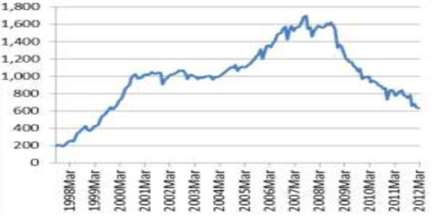

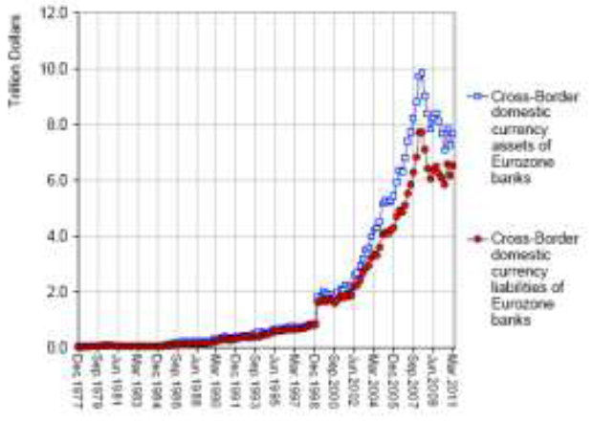

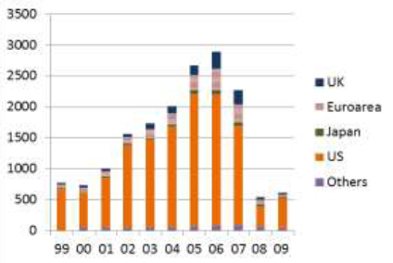

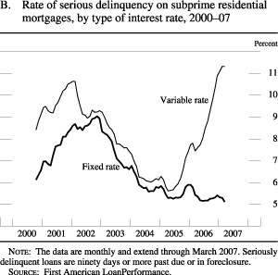

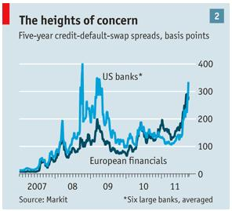
Then came the financial crisis
Higher speed and shorter distance between vehicles
Increased dependence on wholesale funding which also often was quite short term
Deposit funding gap of euro area banks (EURbn) 1998-2008
Increased complexity
Cross-border assets and liabilities, usage of complex derivatives etc.
Cross-border assets and liabilities of euro area banks 1977-2011 (USDtn)
Issuance of asset-backed securities 1999-2009 (EURbn)
CLOs, CDOs, CMBSs and other financial innovations.
Fancy driving
Rate of serious delinquency on subprime residential mortgages 2000-2007
Then suddenly a stray dog in the road
US subprime losses send shivers through the global financial system.
The crash is a fact
Global credit crunch

Slide 11
Enter Basel III
Basel I
Credit only approach to capital
To create level playing field
Standards focused on credit risk, the main risk incurred by banks
Criticised as too simplistic
30 pages
Basel II
Three Pillars introduced:
I. Minimum capital requirements for credit, market and operational risks
II. Supervisory review of an institution’s capital adequacy and assessment process
III. Market Discipline
Requirements typically decreased
347 pages
Basel III
Now also liquidity management and liquidity buffers covered (in addition to capital)
Generally increased minimum requirements – three pillars principles remaining
Increased focus on raw leverage and on systemically important banks.
616 pages
1988 Basel I completed
1993 Standardised model for market risk
1996 Internal model
2008 Basel II implemented
2010 Basel II.5 implemented
2010 Basel III agreed
2013 Basel III implemented

Slide 12




Regulatory response to financial crisis through Basel III and other initiatives quite clear
Regulatory ambition
Regulated through
More capital
Capital ratios
Leverage ratio
Better and longer funding
Net Stable Funding Ratio
Larger liquidity reserves
Liquidity Coverage Ratio
Recovery and resolution framework
Recovery and Resolution Directive

Slide 13

What is ICAAP?
Bank
Regulator
Internal model development and validation
Externally reported capital ratios
Pillar 1
Pillar 2
Pillar 1
Pillar 2
Model approval and review
Internal capital adequacy assessment process (ICAAP)
Regulator’s capital and risk assessment (SREP)
ICAAP “Internal Capital Adequacy Assessment Process” encompasses
Internal views on material risks and developments of those
Internal views on risk measurement models and risk governance and risk mitigants (capital and other)
Internal views on SEB’s capital adequacy, incl. required add-ons on top of Pillar 1 requirements for e.g. concentrations risk and market risk in the banking book
SREP “Supervisory Review and Evaluation Process” encompasses:
Assembling of risk assessments (risks and governance) during the year by regulators co-ordinated by FI
Regulatory views on risk measurement models and risk governance
Regulatory views on SEB’s capital adequacy, incl. required add-ons on top of Pillar 1 requirements

Slide 14
Board requirements in connection with ICAAP
Setting the risk tolerance
Maintain adequate control and measurement of risks
Setting the capital levels and plans
Notes:
As discussed, the ICAAP is the internal capital adequacy assessment process and there are some requirements within the that process set by the regulators that relate to the BoD
It is the resposibility of the Board of Directors to
Set the Risk Tolerance for the group and this is reflected in the requirements on the Board in the ICAAP
Furthermore, it is the responsibility of the Board to maintain an adequate control and measurement of all risks within
Lastly the Board needs to set the capital level and thecapital plan

Slide 15
SEB’s risk appetite framework provides an overall view of the risks within the Bank
Risk
philosophy
7 overall SEB risk guiding principles
1
Board risk tolerance
2
Overall guidelines per risk area
Level of articulation
Management risk appetite
7 risk dimensions
3
Business guidelines, procedures, limits
Specific measurements
and controls
4
15
Notes:
NOTES HEADER IN UPPER CASE
3/31/2014
15
The Risk Tolerance framework is implemented through four levels of detail
The Risk Philosphy level which states the principles of risk within SEB
The Board Risk Tolerance which defines the outer boundaries of risk taking within SEB
The Management Risk Appetite which in more detail specifies how management works within the Tolerance
The policies, methodologies and instructions level which directs the day to day operations

Slide 16

Risk philosophy describes the basis of SEB’s risk taking
Risk taking is not an end in itself but is done for the purpose of providing
customer value and making a return on the shareholders' equity
  SEB only does business where it has a good understanding of the risks and the capacity to manage and control them.
  SEB manages risk as an inherent part of the way it does the business. Every manager is responsible for controlling the risks in their area of responsibility.
  SEB always knows its real position by valuing all transactions and risks correctly.
  SEB makes use of its previous experiences and considers stressed circumstances in its risk taking.
  SEB aims to avoid surprises by estimating and reporting risks well in advance and by adhering to Group policies and principles.
  SEB does not have positions or practices which if known publicly could hurt SEB's reputation
Notes:
Risk taking is not an end in itself but is done for the purpose of providing
customer value and making a return on the shareholders' equity
Understanding and control
Inherent part – front line responsible
Know real position
Learn from experience
Avoid principle

Slide 17



SEB has a well embedded risk appetite framework
Risk Tolerance
Risk Strategy and Appetite
Policies and structures
Strategic
Vison
Strategic
Plan
Business
Plan
Business unit plans
Capital ambition
Capital Plan
Capital allocation
Notes:
The Risk Tolerance framework is well embedded within the Annual business planning cycle.
It works in parallell and there are three documents that are a direct result of the process, the Risk Tolerance docuemnt, The Risk Appetite statements and the Risk Strategy. The strategic plan and business plan can be affected by the risk tolerance and appetite which leads to a discussion at the right level in the organisation
Secondly, the capital planning process is also working in parallell with the business planning process
Taken as a whole, this is the heart of the ICAAP idea, that the business planning is challenged with
”What and how much risks do we want to take” and secondly ”How much capital do we need as a result”

Slide 18
SEB faces seven fundamental sources of risk for which we need to hold capital
Operational risk
A lender
A borrower
A depositor
Lender’s capital we refer to as equity
Liquidity reserve to tackle deposit volatility
Long term funding to fund liquidity reserve
Some bond origination, market making etc
Insurance risk
Short term funding to fund net trading assets
Some “bancassurance”
Vulnerable systems and processes
Pension liabilities to employees
Market risk
Liquidity risk
Pension risk
Threats that could take our business away
Credit risk
Business risk

Slide 19
… and while different tools and methodologies are used to measure each risk ...
Credit Risk
Market Risk
Operational Risk
Notes:
Credit risk is a long term cyclical risk fairly dependent upon the economy as a whole
Market risk is a short term risk, dependent upon the perception or whims of the market
Operational risk is an idiosynchratic risk, dependent upon human operations

Slide 20
… they are all based on the same idea
How much could SEB lose under different future scenarios

Slide 21

Credit risk capital is based on default and loss history
Market risk capital is based market volatility
Operational risk capital is based on the financial worlds mistakes
Insurance risk capital is based on market volatility and actuarial risk
Insurance risk capital is based on market volatility and actuarial risk
Business risk is based on earnings volatility

Slide 22
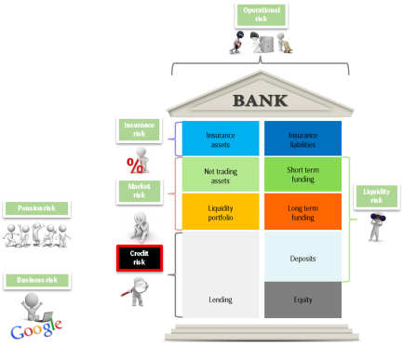
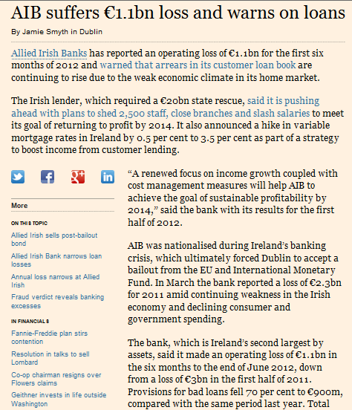
Credit Risk
How much could SEB lose due to credit risk over the next year?
Notes:
Credit risk has been the fundament of financial institutions since they were invented – I will spend some extra time on explaining how we measure credit risk as it is around 80% of the risks that we face.

Slide 23
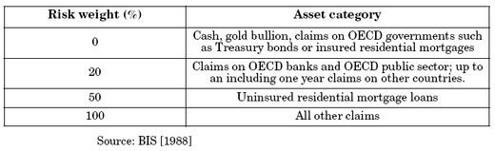
Under Basel I, risk weighting was a way to capitalise different asset classes in a simple way
Exposure conversion
Constant capital percent
Notes:
Going back to 1988, credit risk was measured based on the idea that different asset classes held similar risks.
Gold, treasury bonds to OECD governments were risk free
Claims on OECD banks and public sector held little risk so the exposure was weighted with 20%
Residential mortgages were held at 50% risk weighting of the exposure
Lastly, everything else was taken at exposure value.
For each unit of risk weighted exposure, 8% was needed as capital

Slide 24
Under Basel II, the exposure conversion became risk sensitive
Risk Class | RC1 | RC2 | RC3
Risk Weight | 20% | 100% | 150%
Exposure conversion
Constant capital percent
Notes:
In 2006, the Basel II approach was introduced with a different approach to risk weight the exposures. The basic idea was to use the well functioning credit rating mechanisms in banks to risk weigh the exposures.
The granulaity increased and the buffers held for losses were much more risk sensitive.
The risk weighted exposure was then multiplied by a capital percentage which was held constant at 8%

Slide 25
Three main components are used to calculate the risk sensitive exposure conversion
Probability
of Default
(PD)
A risk class is assigned on every corporate, bank and sovereign counterparty, using internal risk classification system
Every risk class corresponds to a PD, quantifying likelihood of borrower being unable to repay
PD-risk class calibration based on historical default data
Healthy Client
Client at Default
Exposure
at Default
(EAD)
Amount at risk at time of default
Calculation depends upon product type, eg.
  Loan = 100%
  Performance guarantee = 30%
Initial commitment
Commitment reduction
Final commitment
Exposure at
Default
Average
Utilization
Loss
Given Default
(LGD)
‘Severity of loss’
The percentage of exposure that is lost in case of default
Generally depends on the collateral and product type
Notes:
The risk weighting is a bit more complex;
How likely is it that a counterparty defaults is the first parameter to estimate. This is based on the internal risk classification system. The risk classes range from 1 to 16 and represent a probability of default from 0.01% to 100%.
Secondly, some exposures are not utilised at the time of default, and as a result we need to estimate the exposure at default.
Lastly, if the unthinkable has happened, how much should we expect to loose.
You could say that the risk weighted exposure is the recovery value taking likelihood of non payment into account

Slide 26
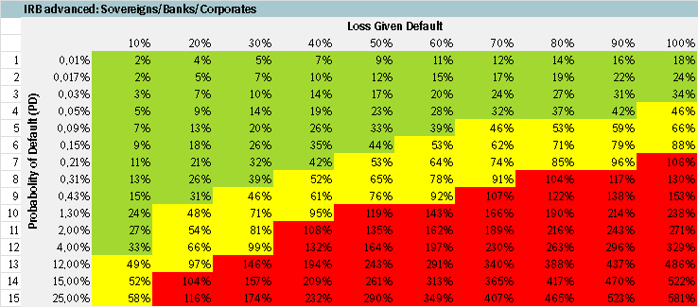

Combination of parameters give the exposure conversion factors – RWA percentages
Large Corp
Mid Corp
SME
Real Estate
Banks

Slide 27
On average the risk weight is 25% for SEB

Slide 28
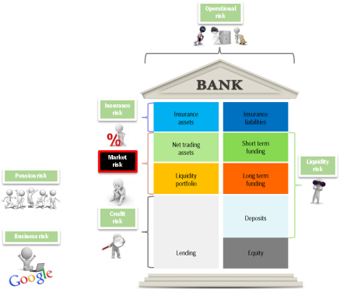
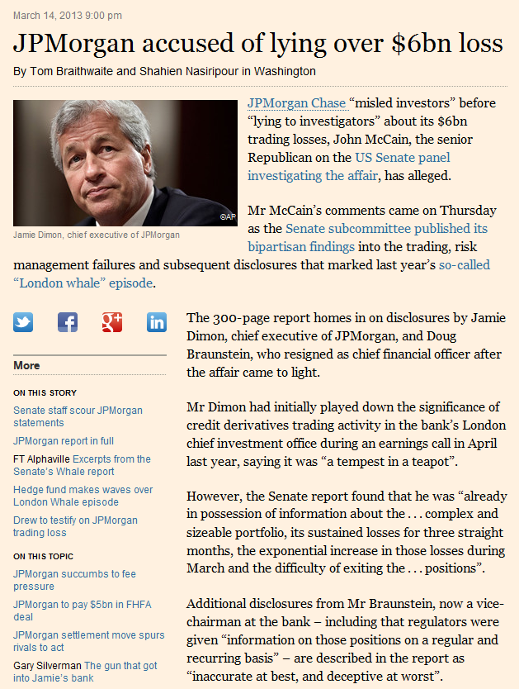
Market Risk
How much could SEB lose due to changes in market values?

Slide 29



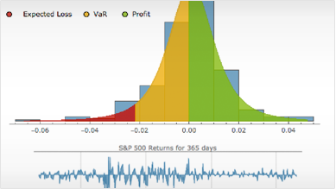
Value at Risk is the method chosen as the foundation for capital requirement but the process is generic
Value at Risk
Expected Shortfall
Delta1
Stress testing

Slide 30
Measuring market risk, Value at Risk (VaR)
We look at the last one year and measure the maximum loss that the Current portfolio would have caused in 1 day with a 99% probability level.
-11,4%
99% change event
Current value of
position
VaR

Slide 31
What affects market risk RWA?
Credit Risk
VaR/RWA
Volatility
VaR/RWA
Concentration
VaR/RWA
Value
VaR/RWA
Position
VaR/RWA

Slide 32
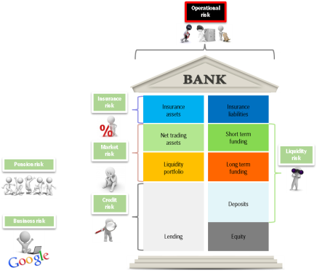
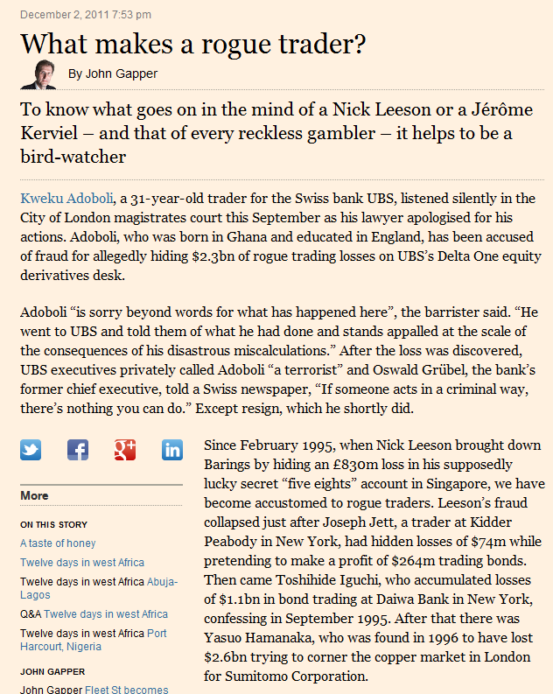
Operational Risk
How much could SEB lose due to operational mistakes?

Slide 33
Operational risks stem from many different sources – all being idiosyncratic and non-profitable
Intentional fraud, collusion or misrepresentation by own staff
Unintentional errors and omissions by internal staff or agents
Man made shocks and disasters - external
Unanticipated loss of resources
Natural disasters
Notes:
Intentional fraud, collusion or misrepresentation by own staff
Rouge trader
Internal theft
Willful misrepresentation of P&L
Sumitomo copper trader – 2500 Mn USD
Unintentional errors and omissions by internal staff or agents
Incorrect accounting, modelling, pricing or risk assessment
Programming and data input errors
Settlement errors
Citibank failiure of controls in Australian loan approval systems
Man made shocks and disasters - external
Externally perpetrated fraud
Unanticipated regulatory changes and changes in tax regime
Unanticipated legal disputes or change in interpretation of the law
Prudential Securities suit from ING for bad advice on purchase – 1200 Mn USD
Unanticipated loss of resources
Loss of key systems
Loss of key personnel
Loss of key suppliers
Citibank cancellation of software contract – 85 Mn USD
Natural disasters
Earthquakes etc.
Accidental damage
Credit Lyonnais fire at HQ – 75 Mn USD

Slide 34





Capital for operational risk losses is estimated by looking at historical events
How often
7
7
12
16
47
Many small losses
Fewer larger losses but still manageable
Disaster
Loss

Slide 35


So far so good …
~
Internal measurement
External measurement

Slide 36
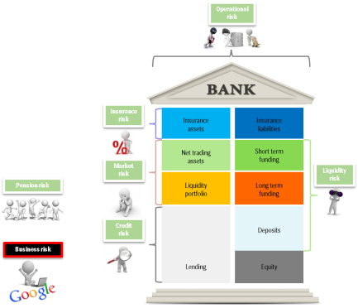

Business risk
How much could SEB lose due to anything else?

Slide 37
Business risk is a catch all to quantify capital for non financial risks
Reputation
Competition
Corporate activity
Notes:
Earnings volatility due to changes in the competitive environment, such as volume/margin/costs changes driven by an increased efforts by other banks focusing on public sector lending
Earnings volatility due to reputational issues and unfavourable public opinion (‘bad press’)
Activity falling, resulting in falling volumes but with static fixed cost base
Included elsewhere
Earnings volatility due to credit losses
– Credit risk
Earnings volatility due to interest rate changes (e.g. prepayments), volatile equity markets, etc.
– Market risk
Earnings volatility due to fraud, fire, theft, etc.
– Operational risk

Slide 38
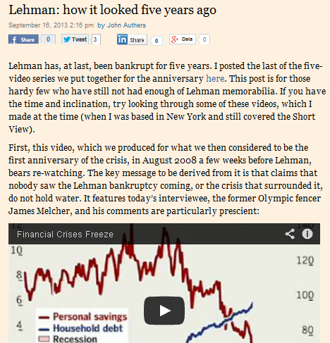
Aggregated risk
How much could SEB lose when everything is considered?

Slide 39
Internally, we assume that not all shocks happen at once
Credit Risk
Market Risk
Operational risk
Insurance risk
Business Risk
Pension Risk
Total Capital Requirement

Slide 40
… while the regulators do not recognise any diversification between risk types
Credit Risk
Operational Risk
Insurance Risk
Pension Risk
Market Risk
Business Risk
Total Regulatory Capital Requirement

Slide 41
Credit risk capital is based on default and loss history
Market risk capital is based on market volatility
Operational risk capital is based on the financial world’s mistakes
Insurance risk capital is based on market volatility and actuarial risk
Insurance risk capital is based on market volatility and actuarial risk
Business risk is based on earnings volatility

Slide 42
Optimal capital level based on several perspectives
1. Dominating view prior to crisis
Internal view
4. Trying to keep up
Optimal capital level
Politicians and regulators
3. Dominating view post crisis
Rating agencies
Equity and debt investors
2. Dominating view during crisis

Slide 43
Equity and debt investors?
Currently there seems to be little doubt that the market verdict is – “sufficiently capitalised”
European banks’ 5 year senior unsecured CDS spreads

Slide 44
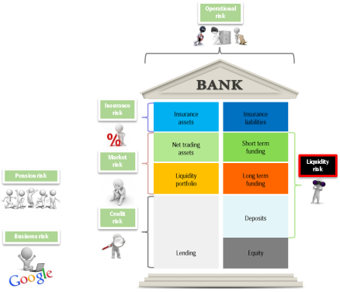
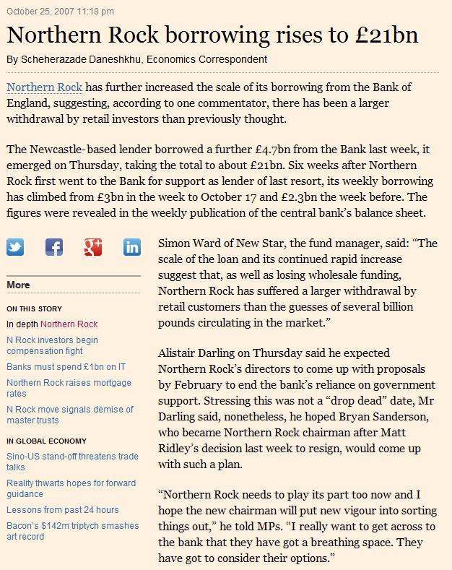
Liquidity risk

Slide 45
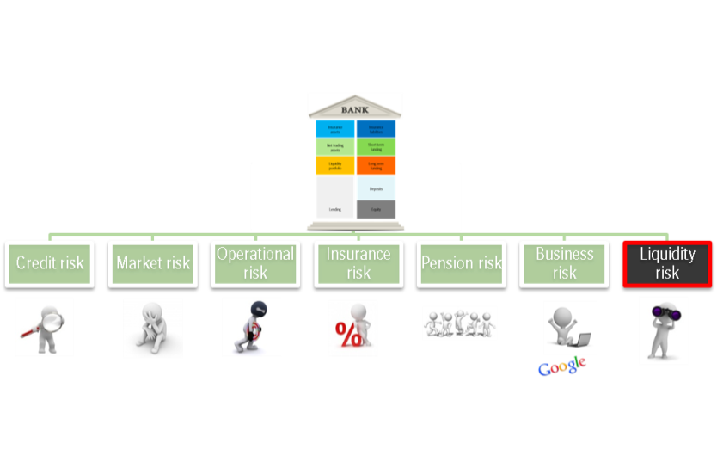
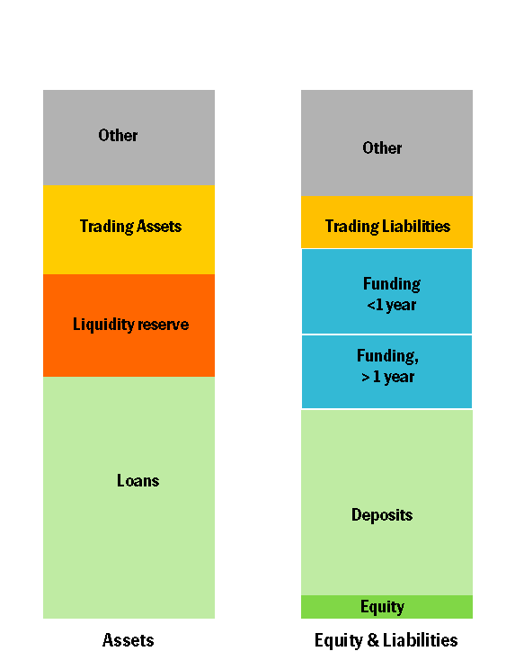
Liquidity risk
Short-term liquidity
Long-term solidity

